Slide 1
Object Oriented Programming using python
By
Sana mateen

Slide 2
Object Oriented Programming
It helps to build modular, maintainable, and scalable applications.
By understanding the core OOP principles—classes, objects, inheritance, encapsulation, polymorphism, and abstraction—
It helps to design elegant and efficient solutions to complex problems.
In Python object-oriented Programming (OOPs) is a programming paradigm that uses objects and classes in programming.

Slide 3
OOPs Concepts in Python
Class in Python
Objects in Python
Polymorphism in Python
Encapsulation in Python
Inheritance in Python
Data Abstraction in Python

Slide 4
Class
A class is a collection of objects.
A class contains the blueprints or the prototype from which the objects are being created.
It is a logical entity that contains some attributes and methods.
Classes are created by keyword class.
Attributes are the variables that belong to a class.
Attributes are always public and can be accessed using the dot (.) operator

Slide 5
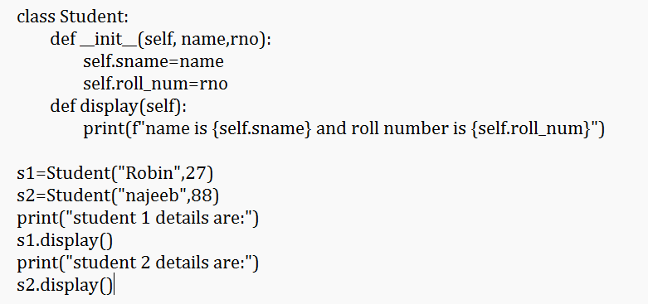
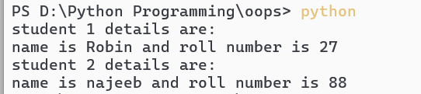
self is a special keyword used in object-oriented programming (OOP) to refer to the instance of the class

Slide 6
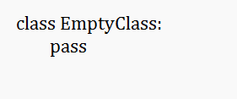
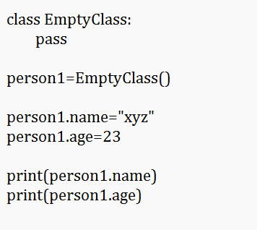
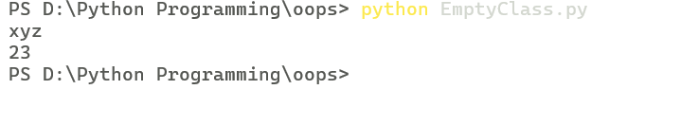
Creating an Empty Class
an empty class is a class that doesn't contain any methods or attributes initially.
We can add methods and attributes later on.

Slide 7
Objects
The object is an entity that has a state and behavior associated with it.
An object consists of:
State: It is represented by the attributes of an object. It also reflects the properties of an object.
Behavior: It is represented by the methods of an object. It also reflects the response of an object to other objects.
Identity: It gives a unique name to an object and enables one object to interact with other objects.

Slide 8

Creating an Object
This will create an object named obj of the class defined above

Slide 9
The Python __init__ Method
The __init__ method is similar to constructors.
It is run as soon as an object of a class is instantiated.
The method is useful to do any initialization you want to do with your object.

Slide 10
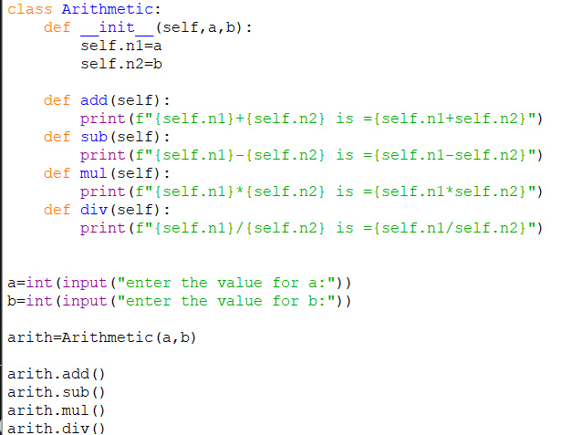
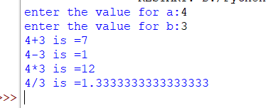

Slide 11
Inheritance
In Python object oriented Programming, Inheritance is the capability of one class to derive or inherit the properties from another class.
The class that derives properties is called the derived class or child class and the class from which the properties are being derived is called the base class or parent class.
The benefits of inheritance are:
It represents real-world relationships well.
It provides the reusability of a code.
We don’t have to write the same code again and again.
Also, it allows us to add more features to a class without modifying it.

Slide 12
Types of Inheritance
Single Inheritance: Single-level inheritance enables a derived class to inherit characteristics from a single-parent class.
Multilevel Inheritance: Multi-level inheritance enables a derived class to inherit properties from an immediate parent class which in turn inherits properties from his parent class.
Hierarchical Inheritance: Hierarchical-level inheritance enables more than one derived class to inherit properties from a parent class.
Multiple Inheritance: Multiple-level inheritance enables one derived class to inherit properties from more than one base class

Slide 13
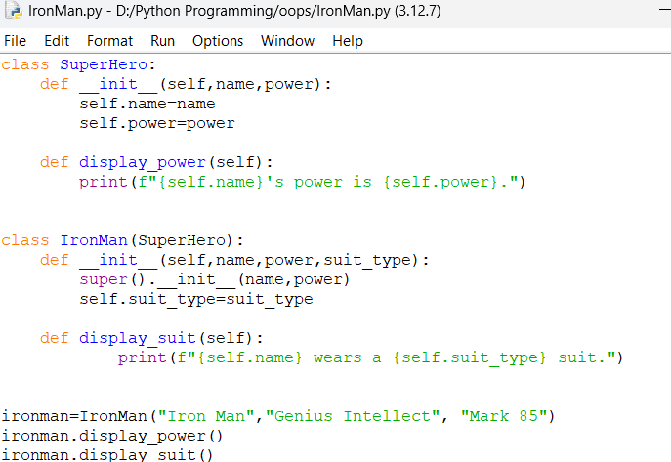

What is super() in Python?
super() is used to call methods of a superclass (parent class) from a subclass (child class).
It returns a proxy object that delegates method calls to the superclass.
This is useful for accessing inherited methods that have been overridden in a subclass.

Slide 14
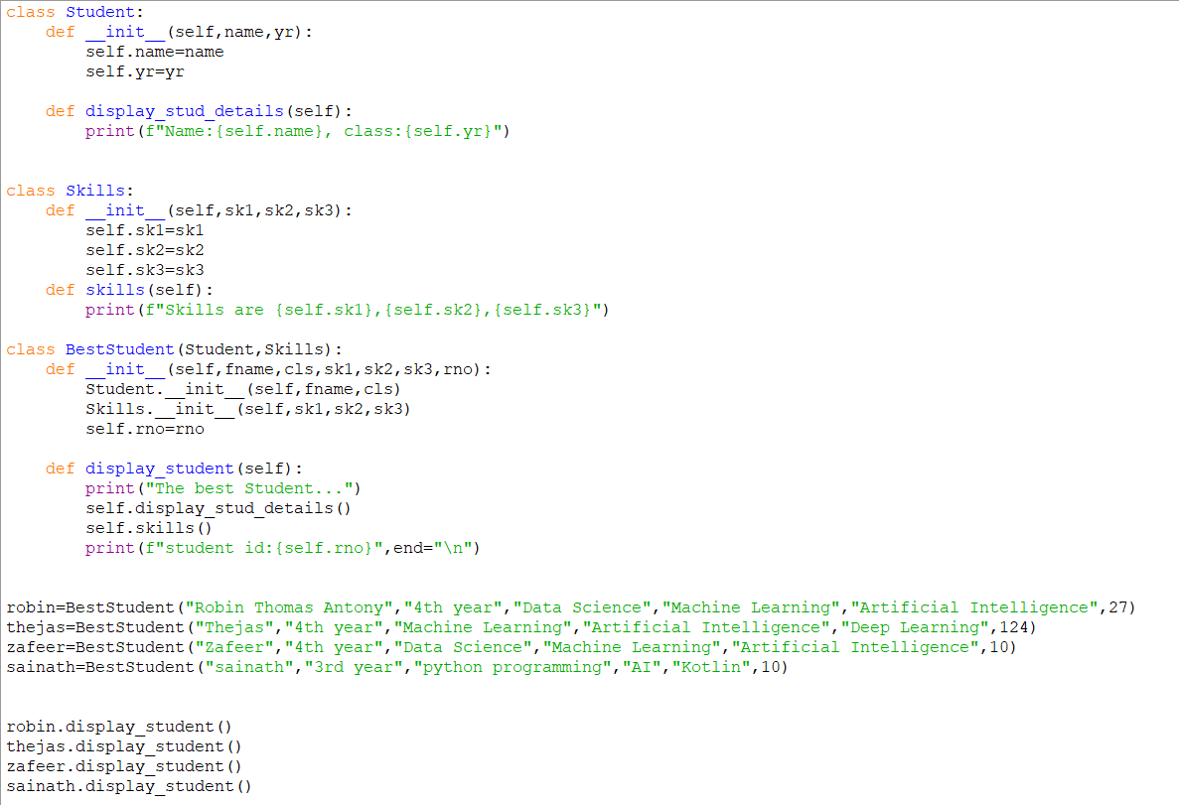

Slide 15
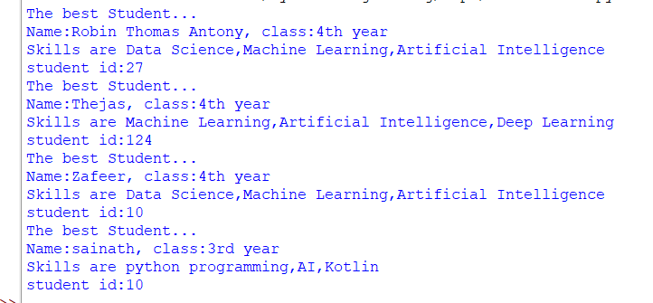

Slide 16
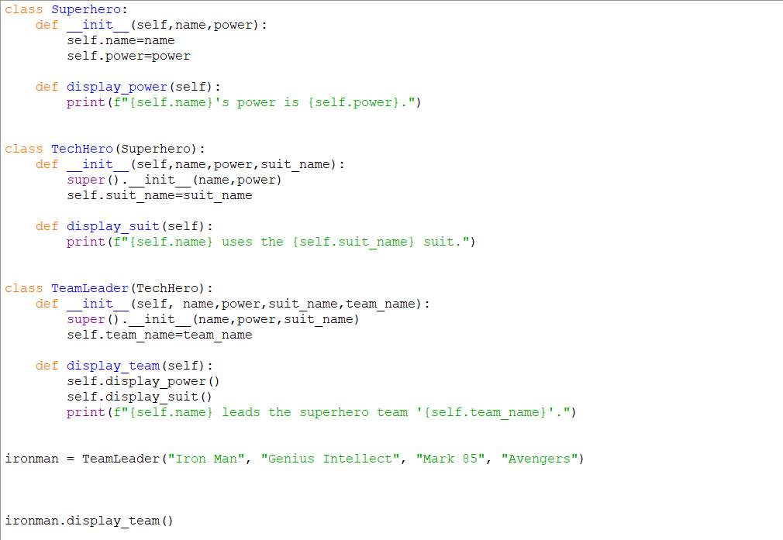

Slide 17


